Slide 1
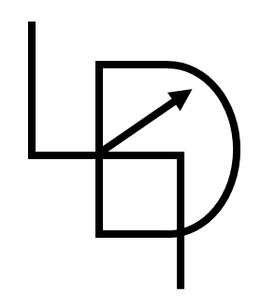
Python Set & Dictionary
Smruti Ranjan

Slide 2
Data Types
Python Data Type
Immutable
Numbers
Strings
Mutable
List
Tuple
Set
Dictionary

Slide 3
Set
Collection of data type
Mutable
Example:
{1,32,68,36.5}

Slide 4
Dictionary
Collection of data type
Mutable
Example:
{"Red“:1, "Green“:2, "Blue“:3}
{1:"Red“, 2:"Green“, 3:"Blue“}

Slide 5
Thanks for watching.
Please do like & share this video, and don’t forget to subscribe this channel.
See you next time.
Until then
Cheers!

